Slide 1
Informatics 43
Lecture 11
“How do we know the software works? (part 1)”

Slide 2
Last Time
We use HCI/UCD methods…
Interviews/observations, personas, scenarios, storyboards, mockups, design guidelines, heuristic evaluation, user testing
…for good reasons
Sales double
Performance doubles
Traffic counts increase
It’s all about the user!

Slide 3
Today’s lecture – How do we know the software works?
Failures: a second look
Quality assurance
Testing: who, what, how

Slide 4
Today’s lecture – How do we know the software works?
Failures: a second look
Quality assurance
Testing: who, what, how

Slide 5
Boeing 737 Reading
“The 737 Max saga teaches us not only about the limits of technology and the risks of complexity, it teaches us about our real priorities. Today, safety doesn’t come first—money comes first, and safety’s only utility in that regard is in helping to keep the money coming. The problem is getting worse because our devices are increasingly dominated by something that’s all too easy to manipulate: software.”

Slide 6
Toyota “Unintended Acceleration”
Source: https://www.caranddriver.com/features/its-all-your-fault-the-dot-renders-its-verdict-on-toyotas-unintended-acceleration-scare-feature

Slide 7
Apollo 8

Slide 8
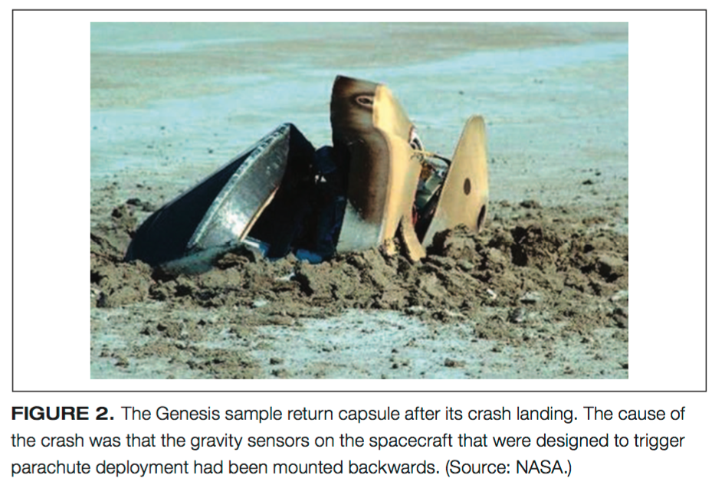
NASA’s Genesis Mission

Slide 9
Mars Polar Lander

Slide 10
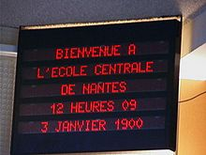
Y2K
Bug description
Date formats were MM/DD/YY, e.g., 01/01/98, 02/02/99, 03/03/00
Does 00 mean 2000 or 1900?
Does 1999 turn to 19100?
Effects
Relatively minor
Cost: $300 billion!
https://codeofmatt.com/list-of-2020-leap-day-bugs/

Slide 11
NASA’s ”Cardinal Rules for Safety”
No single event or action shall be allowed to initiate a potentially hazardous event.
When an unsafe condition or command is detected, the system shall
Inhibit the potentially hazardous event sequence.
Initiate procedures or functions to bring the system to a predetermined “safe” state.
For the full 388-page doc, see:
http://www.hq.nasa.gov/office/codeq/doctree/871913.pdf

Slide 12
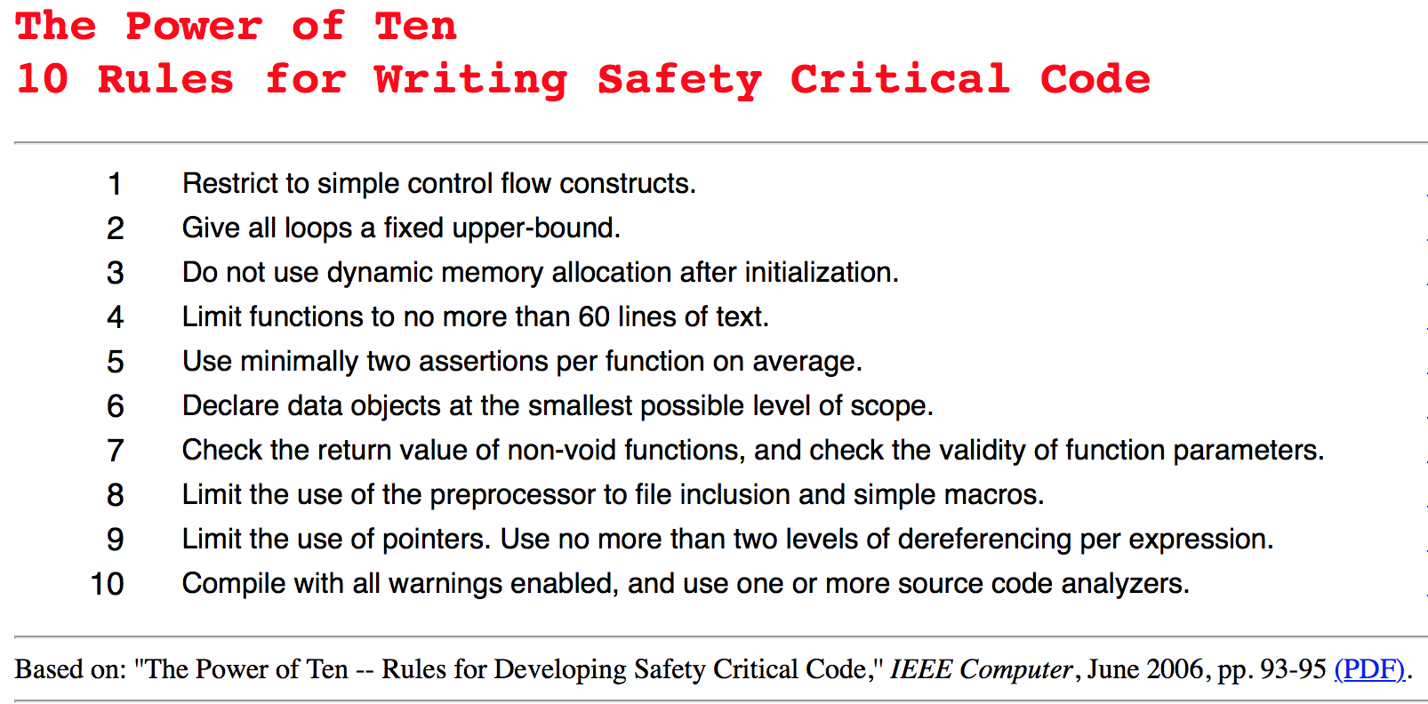
Source: http://spinroot.com/p10/

Slide 13
Today’s lecture – How do we know the software works?
Failures: a second look
Quality assurance
Testing: who, what, how

Slide 14
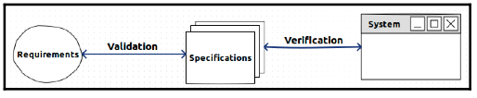
QA Goals: Verification and Validation
Quality Assurance = All activities designed to measure and improve quality in a product
Validation
Verification: Does it conform to specifications?
Validation: Does it serve its purpose?

Slide 15
QA Techniques
Formal methods
Static analysis of program properties
Reviews and inspections
Testing
Use a mixture of techniques!

